Slide 1

Deployment of AI Based Road Inspection System
Muhammad Shahroz, Jerry Zhu
~ November 24, 2022 ~

Slide 2
Methodology
Framework:
Python based Streamlit App Framework is used for user interface building.
Features:
User can input image as a
Imager File
Image url
Output is the uploaded image with:
Predicted class (i.e., type of road defect)
Prediction confidence
Geolocation and Time of input image.

Slide 3
Methodology
Model Options for classification:
ResNet152V2 (Crack & Groove)
Deep Hybrid EfficientNetB0 (Crack & Groove)
MobileNetV2 (Rut & Subsidence)
Deep Hybrid EfficientNetB0 (Rut & Subsidence)

Slide 4
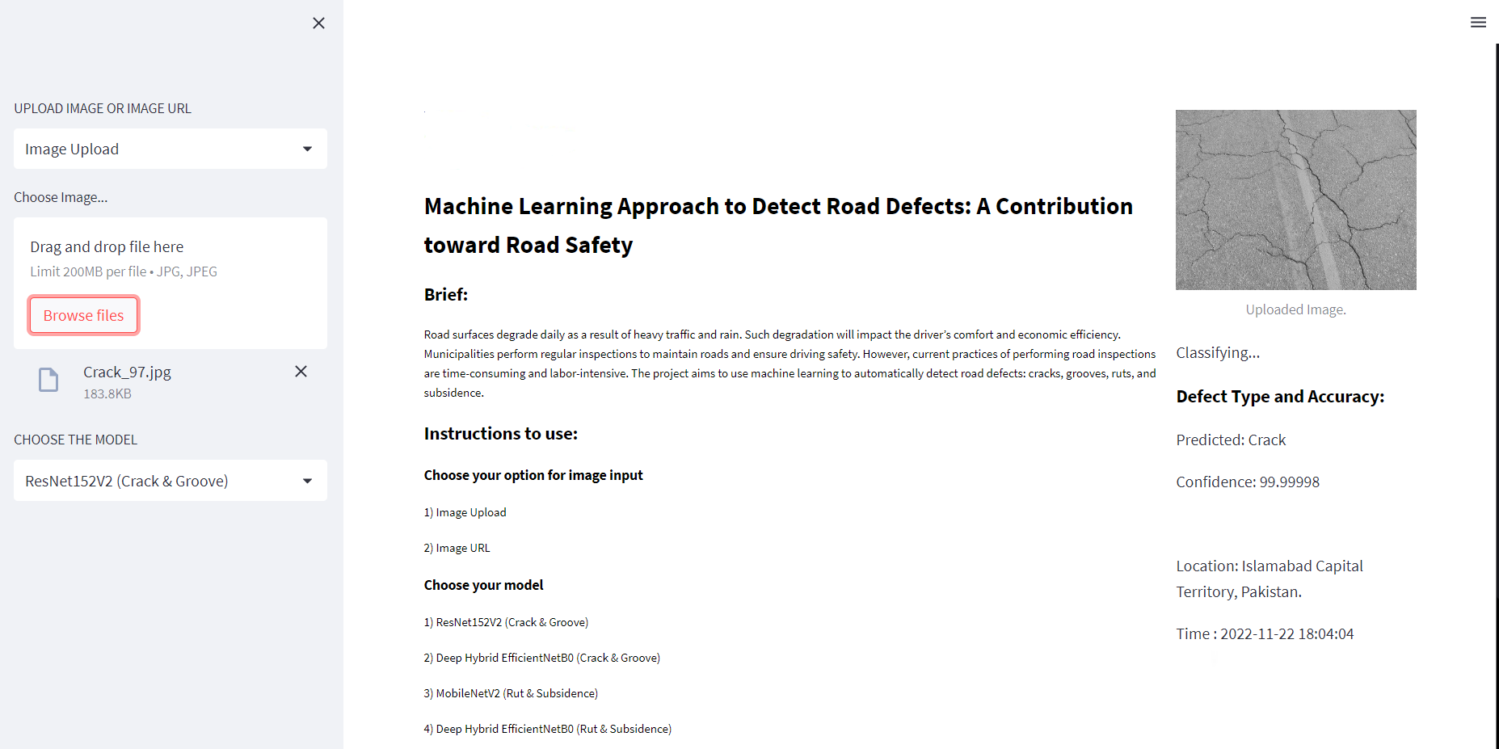
Layout

